Slide 1
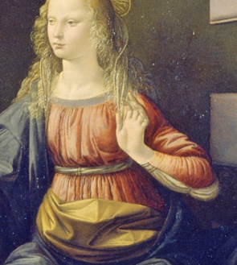

The Politics of Freedom
Prof. Helen Alvare
Feb. 7th, 2013 at 7:30-9:00 pm
Free and Open to the Public
Woulfe Auditorium
Anderson Student Center
Sponsors: the Siena Symposium for Women, Family, and Culture and the Prolife Center.
For more information please contact Dr. Lemmons at rmlemmons@stthomas.edu or Prof. Collett at tscollett@stthomas.edu. Please contact Kimberly Schumann in Disability Services at 651.962.6315 or kjschumann@stthomas.edu for any accessibility requests.

